Slide 1

Reviewer comment response
Mayand Dangi
Wide Bandgap Materials and Device Lab
Department of E.C.E, University of Wisconsin-Madison

Slide 2

Comment
in the discussion of samples HC1-2 where the AlN interlayer thickness is varied, it is stated that the improved mobility for the sample with the thicker interlayer is due to reduced wave function penetration into the AlGaN barrier and the resulting reduction in ionized impurity scattering from the dopants in the barrier. Could reduced alloy scattering from the barrier also be contributing to the observed effect?

Slide 3
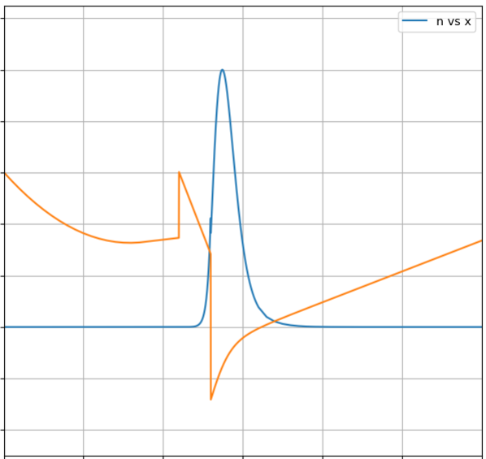
Penetration Probability
AlN interlayer (in nm) | Probability in channel | Probability in interlayer | Probability in barrier
0 | 0.8775 | 0 | 1.225e-01
1 | 0.9506 | 0.0489 | 4.165e-04
2 | 0.9497 | 0.0504 | 7.576e-07
Barrier
Interlayer
Channel
Calculations show a drastic decrease in the electron wavefunction’s penetration into the AlGaN barrier when increasing the AlN interlayer thickness from 1 nm to 2 nm.
Probability of finding electrons in the barrier drops from 4.17×10⁻4 at 1 nm to 7.58×10⁻7 at 2 nm, indicating a much smaller overlap with the barrier region.

Slide 4
Mobility
 | n_2DEG | Total Mobility | Alloy Disorder Mobility | Optical Phonon Mobility | Remote Barrier Mobility | Alloy Disorder Barrier Penetration | Alloy Disorder Only Channel
1nm | 1.04E+17 | 1.4817280549E+02 | 2.8065152546E+02 | 8.6224199091E+02 | 5.1196048826E+02 | 1.7932427628E+08 | 2.8065196470E+02
2nm | 1.10E+17 | 1.9546540097E+02 | 2.7550551459E+02 | 8.4334410513E+02 | 4.4513986455E+03 | 5.4179875659E+13 | 2.7550551459E+02
Ionized Impurity Scattering Increasing AlN interlayer thickness →decreased ionized impurity scattering from dopants located in the barrier.
As seen in the table, the ionized-impurity-limited mobility improves from ∼5.12×10² cm²/V·s (1 nm) to ∼4.45×10³ cm²/V·s (2 nm).
Alloy Scattering Simulations indicate alloy disorder scattering in barrier has decreased with increasing AlN thickness due to less penetration of wavefunction into the barrier layer.
Alloy disorder scattering in channel is roughly same for both cases, slight difference is observed due the difference in 2DEG density.

